Slide 1
Salesforce user training
Customer Relationship Management (CRM) is an indispensable tool in today's business world. These slides guide you through Salesforce, one of the world's most widely used customer relationship management platforms.
Responsible of document: Dyhia and Samira
Author of document : Atif SATIF

Slide 2
Introducing Salesforce
What is a CRM?
The Power of Salesforce
Getting Started with Salesforce
Creating a Salesforce account
Logging in to Salesforce
Navigating the Home Page
Exploring Salesforce Features
4. Optimising Your Salesforce Interface
5. Creating a Stellar Salesforce Profile
1. Maximising Your Data Input
2. Organising Your Folders
3. Optimising Your Sales Processes
6. Collaborating Across Teams with Salesforce
7. Salesforce Tips and Tricks
8. Navigation
9. Account and Contact Creation
10. Lead, Opportunity, and Task Creation
11. Driving Success with Salesforce
12. Best Practices and Tips
13. Sending Emails in Salesforce
14. Adding Products to Salesforce
15. Creating a Quote in Salesforce

Slide 3

Salesforce User Training: MaximisingYour CRM Experience
Looking to get the most out of your Salesforce experience? Join us to learn the basics of CRM, how to navigate Salesforce, and best practices for getting the most out of your platform.​
​

Slide 4

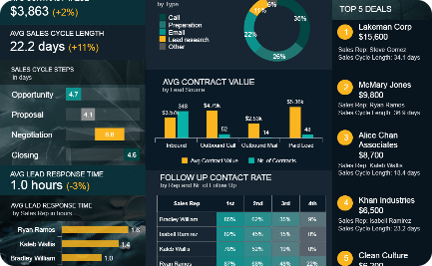
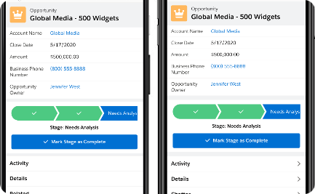
Introducing Salesforce
The global leader in CRM
Customisable dashboard
Application mobile
With Salesforce Mobile, access your data on your mobile, even when you're on the move. Keep your customers in your pocket wherever you are.
Salesforce is the most widely used customer relationship management platform in the world. It is used to improve collaboration between teams and to better understand customer expectations.
Easily track your company's performance, manage your sales activity in real time, and take advantage of predictive analysis to improve your customer relations.

Slide 5



1. What is a CRM?
Customer Relationship Management
Managing Customer Information
Tracking Sales and Progress
A CRM is a software that helps businesses manage interactions with customers and streamline processes to improve sales and customer satisfaction.
CRM tools help businesses keep track of customer data, such as contact information, communication history, and specific preferences or needs.
CRMs also track sales activity and progress toward revenue goals, providing insights and analytics to help businesses make data-driven decisions.

Slide 6
2. The Power of Salesforce
Superior Customizability
Salesforce offers unparalleled customization options, allowing businesses to tailor their CRM to their specific needs and make the most of their data.
Seamless Integration
With a comprehensive suite of products and integrations with over 4,000 apps, Salesforce provides a seamless and scalable solution for businesses of any size.
Industry-Leading Security
Salesforce is dedicated to maintaining the highest standards of security, ensuring that all sensitive data is protected and secure
Constant Innovation
Salesforce continues to innovate, introducing new features and capabilities to keep businesses ahead of the curve and at the forefront of their industries.

Slide 7
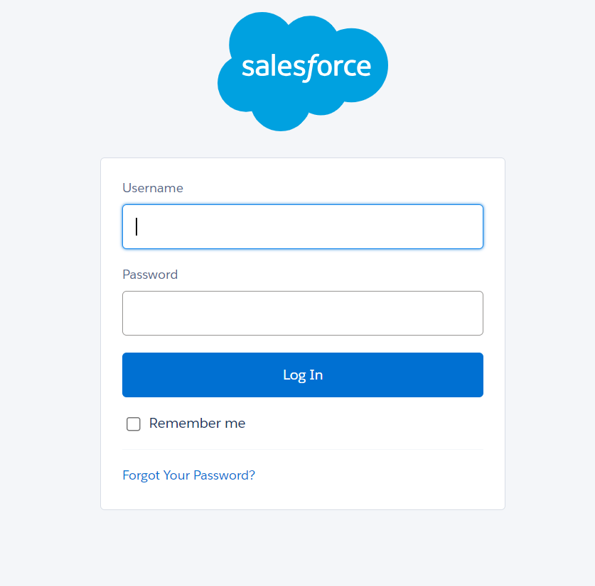
3. Getting Started with Salesforce
Creating a Salesforce edition account
Start by registering for a Salesforce account, choosing the right edition for your business and creating a custom domain.
Logging in to Salesforce
To connect to the Salesforce platform, simply follow this link: https://login.salesforce.com/
You can login to Salesforce from anywhere, on any device, using your custom URL and login credentials.
A verification code can be requested

Slide 8
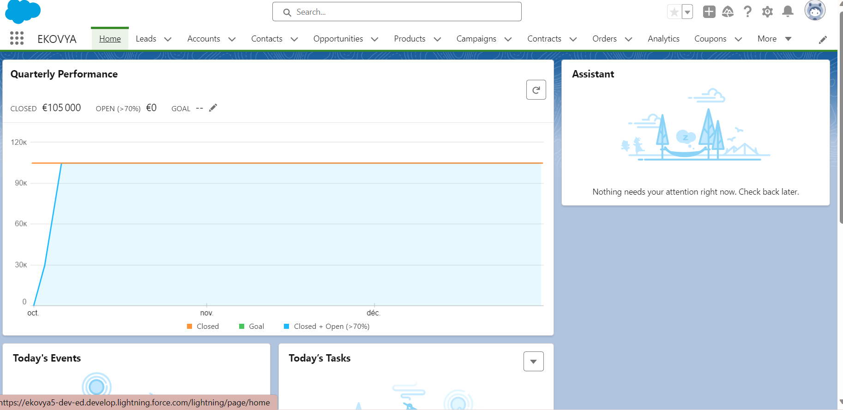
Navigating the Home Page
The Salesforce Home Page is the central hub for your Salesforce experience, allowing you to access your primary tools, reports, and more, all in one place.

Slide 9
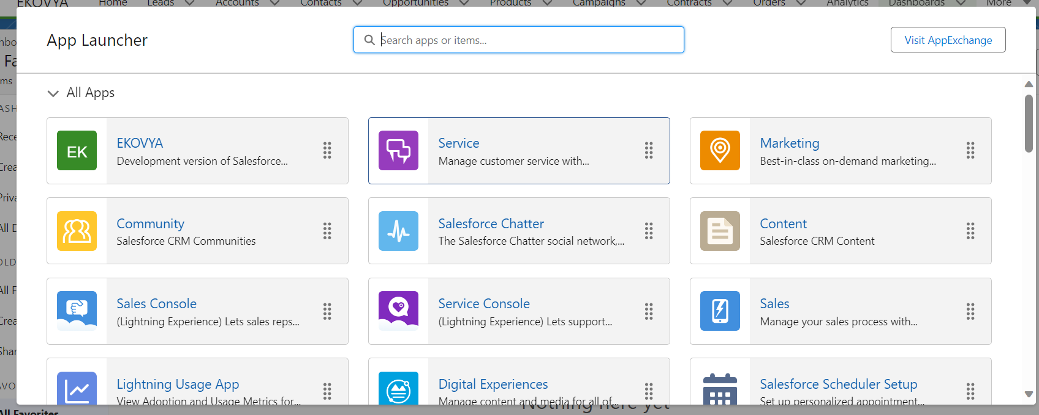
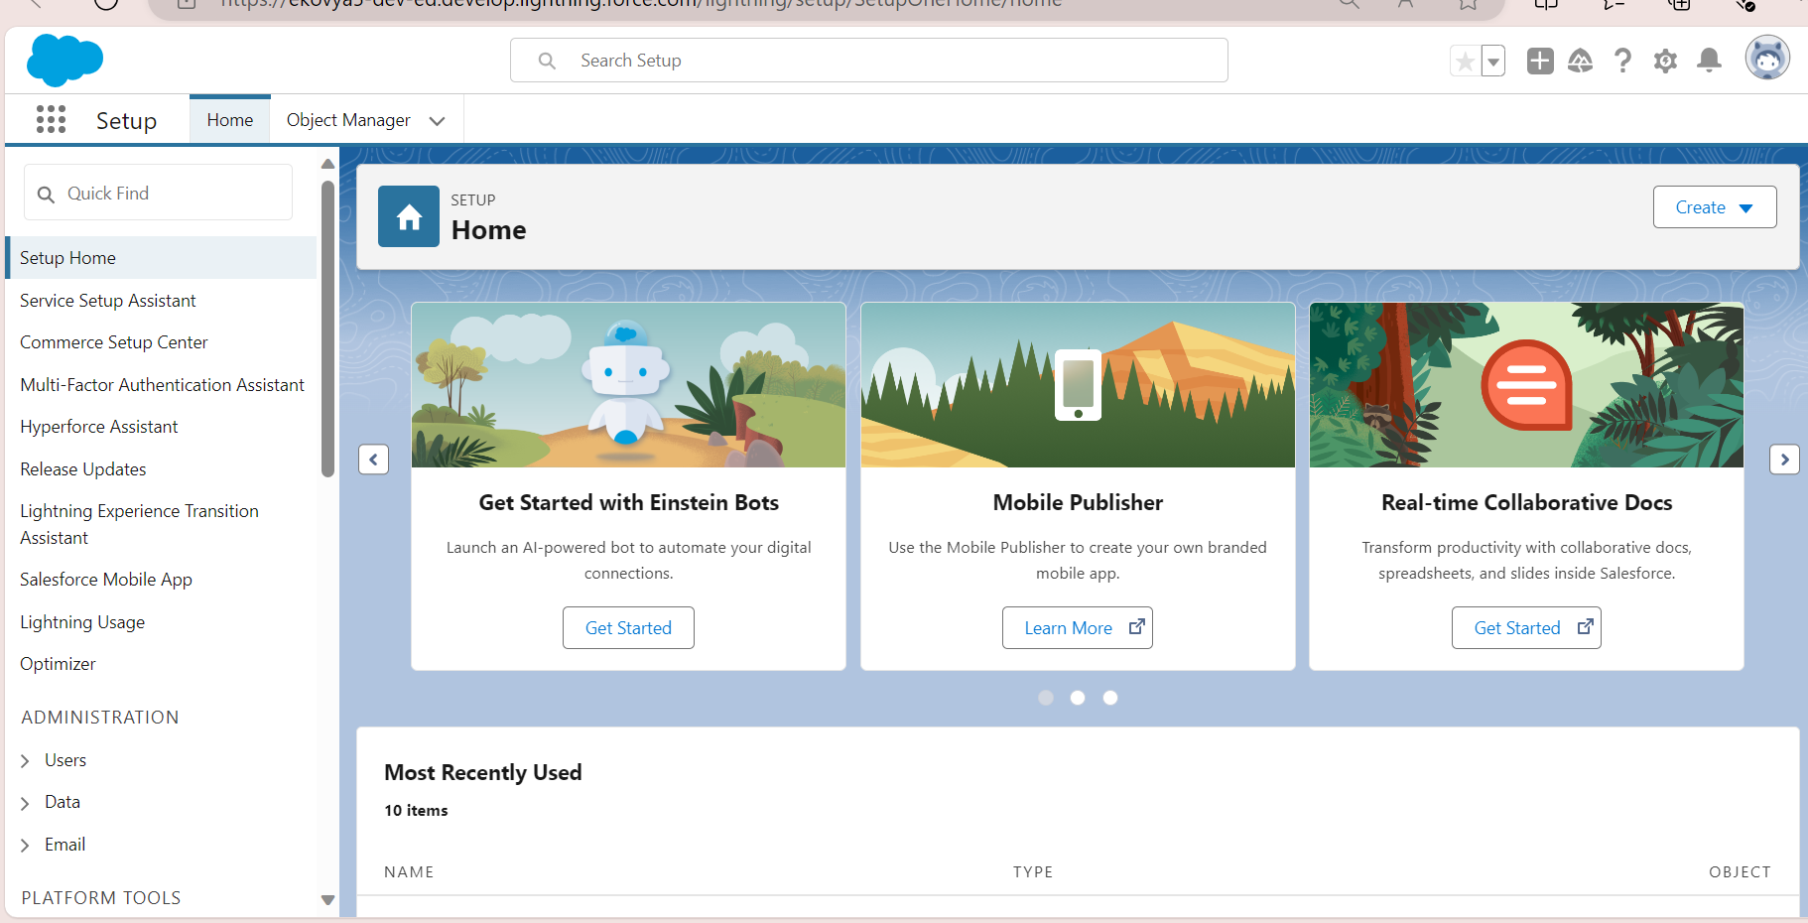
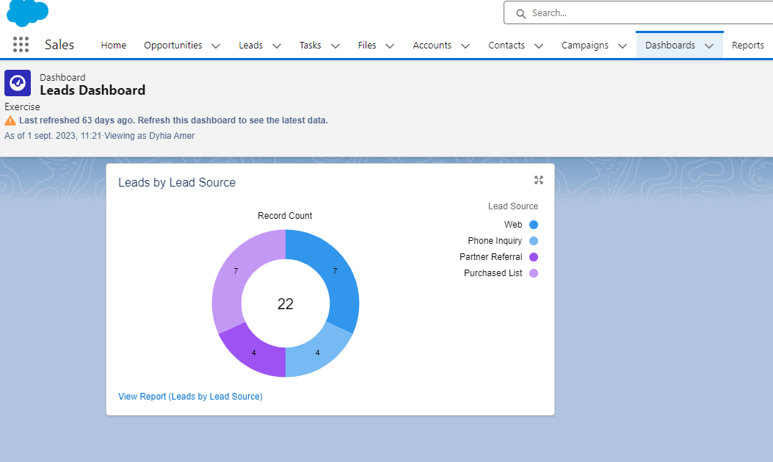
Exploring Salesforce Features
Take some time to explore the features and settings in Salesforce, including dashboards, reports, integrations with other apps, and more!

Slide 10
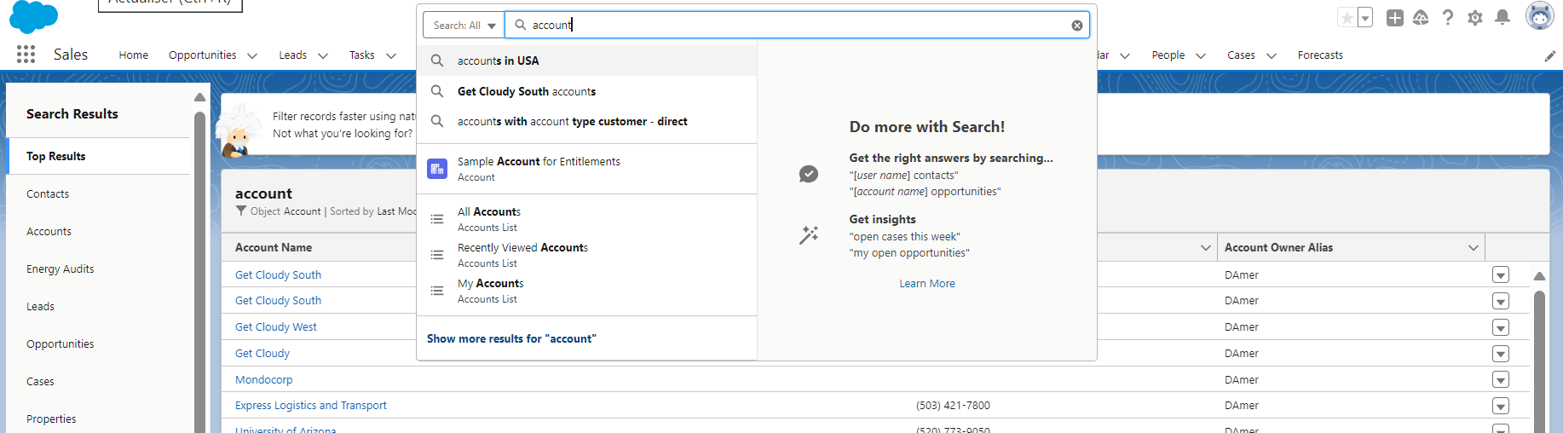
8. Navigation
The search bar allows you to search the entire database.
2. can filter the search by object, as in the example above.
3. Add a * for a broader search

Slide 11
5. Creating a Stellar Salesforce Profile
Maximising Your Data Input
Create detailed customer profiles with enhanced input fields, keeping track of all critical contact data and remaining up-to-date with important client information.
2. Organising Your Folders
Keep your Salesforce data organised and easy to navigate, with intuitive folder structures and suitable permissions and access levels for your team members.
3. Optimising Your Sales Processes
Streamline your sales processes in Salesforce, automating essential tasks and creating more efficient workflows that save time and resources.

Slide 12



4. Optimising Your Salesforce Interface
Customising your Dashboards
Optimising your Mobile Experience
Streamlining your Settings
Customize your Salesforce dashboards to your specific needs & interests, so you can quickly access key information and helpful reports, right when you need it.
Take your Salesforce experience on-the-go, with mobile apps that allow you to access your CRM data and tools from any location, on any device.
Customize your Salesforce settings for maximum efficiency, streamlining your tools and task flows to better suit your unique requirements.

Slide 13
6. Collaborating Across Teams with Salesforce
Fostering Teamwork | Promoting Transparency | Driving Results
Encourage team collaboration in Salesforce, using chat, activities, and document sharing to work together efficiently towards a common goal. | Create a culture of transparency by communicating regularly and publicly in Salesforce, providing updates, sharing reports, and increasing company-wide engagement. | Empower your team members to achieve their potential by providing the right tools and resources in Salesforce, building a culture of continuous improvement with measurable results.

Slide 14
7. Salesforce Tips and Tricks
Salesforce Feature
How to Use It
Salesforce Lightning Experience
Enable the new interface to access more features and streamline your Salesforce experience.
Custom Reports and Dashboards
Create custom reports to access key data more quickly and generate new insights.
Social Media Integrations
Integrate Salesforce with social media for deeper insights into customer activity and behaviour.

Slide 15
Salesforce User Training: customize account, contact, lead, opportunity and tasks
Welcome to Salesforce User Training! In this presentation, we'll cover five essential topics: customize account, contact, lead, opportunity and tasks

Slide 16
9. Account and Contact Creation
Create New Accounts
An 'Account' in Salesforce is a company you do business with.
If you are dealing with a single person, an independent contractor or a consumer use "person account".
Account's user guide :
2. Add Contacts
A contact in Salesforce is a person at a company registered in 'Account'.
This tab contains all the company's employee information.
Contact's user guide :

Slide 17
10. Lead, Opportunity, and Task Creation
From Lead to Opportunity
Leads are people and companies identified as potential customers.
A lead can be converted into an opportunity, account or contact.
User Guide Create Leads :
2. Identifying Potential
In Salesforce, opportunities are deals in progress.
You can create opportunities for existing accounts or by converting a lead.
User Guide Create Opportunity :
3. Task Management
Tasks are like Post-it reminders.
You can assign tasks you create to other collaborators.
User Guide Create a Tasks :

Slide 18
11. Driving Success with Salesforce
Streamlined Workflow
Data-Driven Insights
Discover how Salesforce can streamline your workflow, enhance collaboration, and boost your team's productivity and success.
Unlock the power of data-driven insights to make informed business decisions and drive revenue growth using Salesforce's reporting and analytics tools.
Improved Customer Relationships
Automation and Efficiency
Learn how Salesforce empowers you to build and strengthen customer relationships by providing a comprehensive view of customer interactions and preferences.
Discover how to automate manual processes and improve efficiency by leveraging Salesforce's automation features, saving time and resources.

Slide 19
12. Best Practices and Tips
Data Hygiene
Learn how to maintain clean and accurate data in Salesforce, ensuring the quality and reliability of your business insights.
2. Collaboration and Communication
Discover best practices for collaborating with team members and utilizing Salesforce's built-in communication tools effectively.
3. Continuous Learning
Stay ahead of the curve by exploring Salesforce's vast ecosystem of resources and communities to keep honing your skills.

Slide 20
Salesforce User Training: Mastering Email, Products, and Quotes
Welcome to Salesforce User Training! In this presentation, we'll cover three essential topics: Sending Emails, Adding Products, and Creating Quotes.

Slide 21
13. Sending Emails in Salesforce
1
Email Templates
Create and customize pre-designed email templates to save time and ensure consistent messaging across your organization.
2
Contact and Lead Emails
Master the art of reaching out to contacts and leads directly through Salesforce, keeping track of all your communications in one place.
3
Automated Email Campaigns
Explore the power of marketing automation with Salesforce and unleash the full potential of your email campaigns.
4
User guide Send Email

Slide 22
14. Adding Products to Salesforce
Product Catalog | Product management | User guide
Build an extensive product catalog in Salesforce, complete with detailed descriptions, pricing, and images for each item. | In Salesforce you can add products and create different price books for the same products. Example: customer price book Reseller price book | User guide Add Product and Price book:

Slide 23
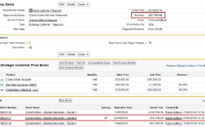
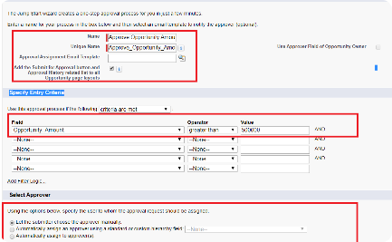

15. Creating a Quote in Salesforce
Streamlined Quote Creation | Quote management | User guide
Discover the step-by-step process of creating professional quotes in Salesforce, complete with product details, pricing, and terms. | Steps to create a quote: Select an opportunity Add products Indicate prices, discounts and delivery charges Create a pdf document to give to the customer or send by e-mail | User guide Create Quote :

Slide 24
Best Practices for Using Salesforce
Data Hygiene: Keep your Salesforce data clean and accurate.
Automation: Leverage workflows, process builders, and AI-powered tools.
Reporting & Dashboards: Extract actionable insights from your Salesforce data.
Security: Implement robust security measures to protect sensitive information.

Slide 25
Thank you for your trust!
Responsible of Document: Samira MHAMSA, Dyhia AMOUR
Author: Atif SATIF

